Slide 1
UVIC Access
We Are The Pandas
David Clark, Adnan Duale & Kushal Patel

Slide 2
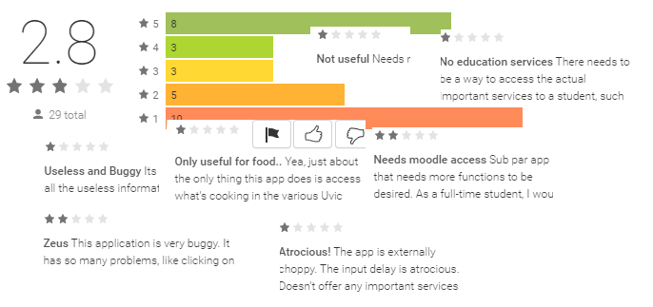
Our Task:
To judge and demonstrate the feasibility of improving or replacing the current Uvic mobile app.
Our motivation:
Current app is unpopular, with few downloads.
Current app has received poor reviews.
Current app lacks obvious features, and many existing features are poorly implemented.

Slide 3
Our Approach:
We assessed three broad approaches for feasibility:
Enhance the current app.
Replace the current app with an official Uvic app.
Replace the current app with an unofficial 3rd party app.

Slide 4
Feasibility assessment: None
Enhance the current app:
Was developed and released in April 2013 by Toronto-based software company AppArmour in cooperation with Student Affairs.
Apparmour’s business model depends on low-cost generation of very similar apps according to a basic template they apply to any institution that approaches them.
3-year contract ended in April 2016, will not be renewed.
Apparmour has no incentive to develop a more feature-complete app; their pricing model depends on minimal customization.

Slide 5
Feasibility assessment: None
Official 3rd party app:
University Systems is in the initial stages of developing a replacement app in conjunction with Ellucian Company Ltd. of Virginia, USA.
No further information about this process is available to students.
The design of the app is not open to student input at this time.
Ellucian is similar to AppArmour in that their sample apps and feature lists show very little accommodation for idiosyncratic campus needs – their features are generic and focus on event calendars, parking maps, etc.

Slide 6
Feasibility assessment: Almost None
Unofficial 3rd party app:
Technically possible.
However, due to Canadian trademark law, an unofficial app would be unable to brand itself as a ‘UVic’ app, or take advantage of official UVic logos, colours or marketing support.
Can expect UVic to be hostile to a competing app; may be able to deny access to third parties to UVic information through either technical or legal means.
Any attempt to gather information on events, courses, registration or grades without UVic’s cooperation would rely on screen-scraping or parsing of raw server reply data – error-prone, time-consuming and unreliable.

Slide 7
One possible set of circumstances may make a student-created app design viable:
Hypothetical scenario: Uvic’s negotiations with Ellucian fail, and in desperation the University puts out a call for 3rd-party app designs.
With this hypothetical in mind, we have created a ‘spec’ design, that addresses the feature and UI issues that most predominate in negative user feedback.

Slide 8
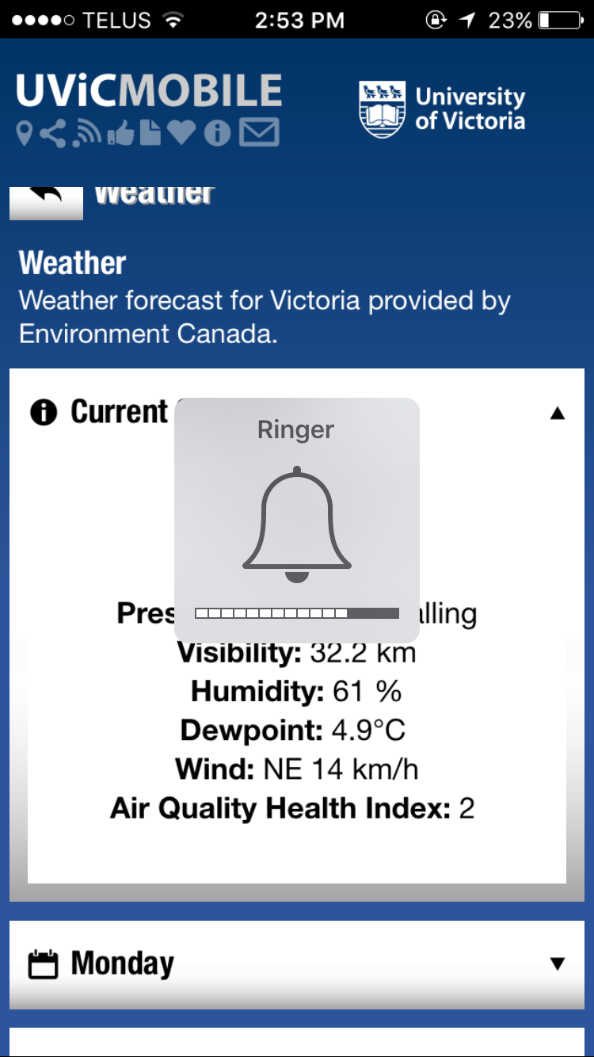
Current app feature review
Fully implemented: accessible features coupled to up-to-date information that is available from a variety of websites, but can be difficult to access quickly on a mobile device.

Slide 9
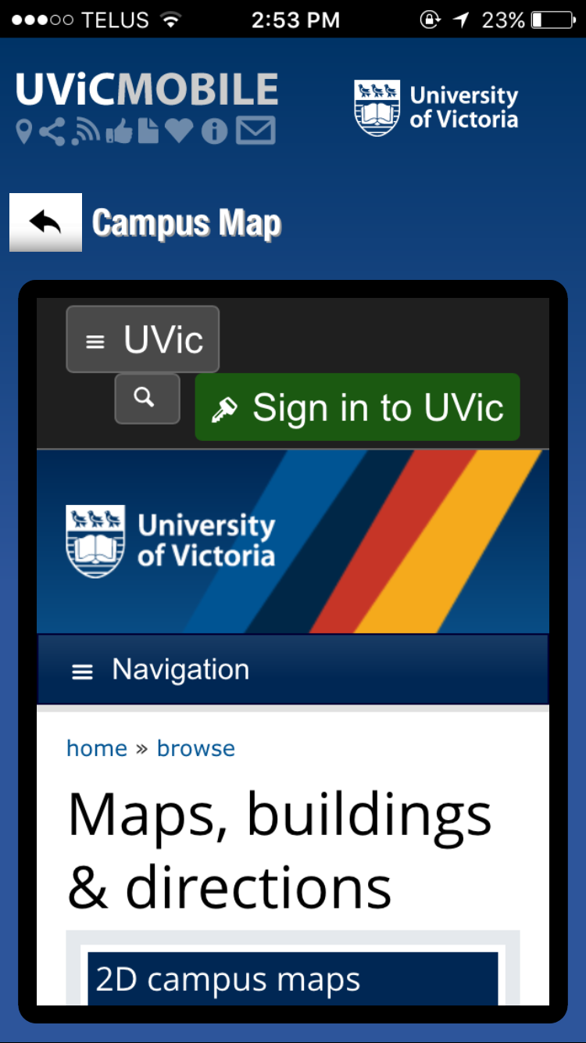
Minimally implemented: Basic browser views of websites that were designed to be viewed on desktop browsers. Actually less convenient than using phones’ built-in browser.

Slide 10
Category | Feature | Fully | Minimally
Events | Today’s Events, This Week’s Events, This Month’s Events | X
Events | Date, Category, Description, Time, Pricing and Location | X
Events | Search by category | X
Campus Map | 2d, 3d accessibility and parking |  | X
Transit | A list of next 4-5 buses leaving UVic for each route, with times and bay number | X
Weather | Environment Canada feed for upcoming week | X
Campus Dining | Opens the corresponding section of the UVic website |  | X
Social Media | Opens browser views of UVic’s Facebook, Youtube, Youtube (Vikes), Flickr and 4 different twitter accounts |  | X
Security | Buttons to call 911 and campus security | X
Security | Browser views of campus security location map and website |  | X
Safety Tools | Loud alarm, flashlight (iPhone only), email your location, security alerts | X
Other | Link to UVic website |  | X
This list omits ‘no-brainer’ features that the current app doesn’t include at all. Our next step to address this omission was to look at best-in-breed apps available to other institutions.

Slide 11
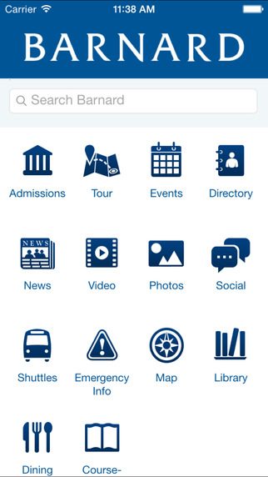
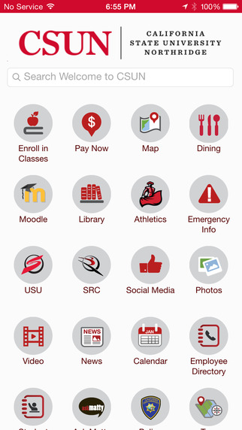
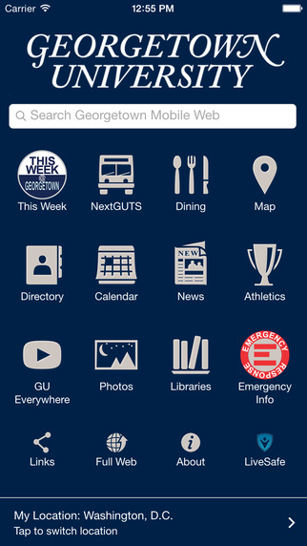
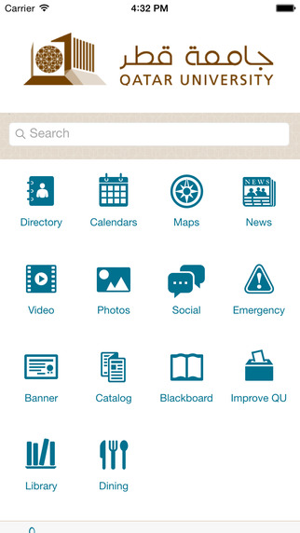
Other efficient Mobile Apps
There exist many Mobile apps that contain effective features that we have found would be useful in Uvic Mobile app.

Slide 12
After Research
The top six universities or colleges who created most appealing mobile apps are the following:
Barnard College: Virtual Tour
California State University Northridge (CSUN): Indoor Maps
Qatar University (QU): Multiple Languages
Fitchburg State University (FSU): IT Help
University of Massachusetts (UMASS): Notification and Banner Messages
Georgetown University: Event of the week.

Slide 13
Recommending features and a new design
New design adopts features from the current app and introduces the following features:
MyPage - requires netlink login
Webmail - requires netlink login
Connex - requires netlink and connex login
Coursespaces - requires netlink login
Enhanced Maps View
View Current Location, Campus Map, Residence Map, Building Map
Notes:
Kushal describes the new features added and shows the new UVIC Access prototype design
To run the prototype, the browser needs to install “Balsamiq Mockups 3 for google drive”

Slide 14
New Features
MyPage
Home, Student Services, Research, Library
Coursespaces & Connex
Access registered courses (view resources, submit assignments, check grades)
Webmail
Access to UVIC Webmail, Send/Receive/Save Messages

Slide 15
via Balsamiq Mockups 3
Prototype Demo

Slide 16
A new app
The new app design is feasible; it is possible to create a UI and feature design that combines the features required in a modern University App with a design that is attractive and usable.
There are no conceptual or practical obstacles; those that remain are political and bureaucratic.
Uvic currently outsources the development of their app, our project suggests forming a team of researchers and developers (already on payroll or UVIC MSC/MSENG students)
Notes:
talk about virtual tour

Slide 17
Questions and recommendations?

